Slide 1
Kinetics Lab (KIN) Final Presentation
Group Name: Just Diene (Group 6)
Instructor: Dr. Marat Orazov
Date: May 13th, 2021
Group Members:
Daniel Robinson Abdul Fayeed Neel Shah Evan Sciacchitano

Slide 2
Agenda
Objectives and Background
Safety
Data Analysis
Rate order determination and Arrhenius Parameters
Application of rate law
Autocatalytic nature
Reactor sizing
Sensitivity Analysis
Conclusion and Recommendations
Questions

Slide 3
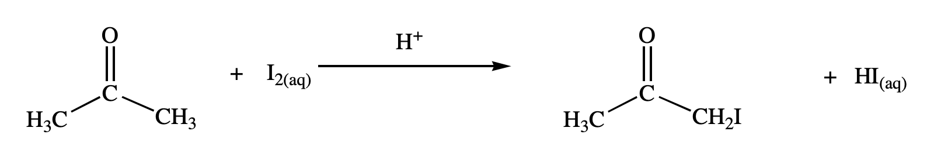


Objectives
Understand the mechanism of the reaction that models the iodination of acetone.
Use MATLAB p-code to simulate the experiment by varying the temperature, initial concentrations of acetone, hydrochloric acid, and iodine in several trials.
Analyze data and perform calculations to determine rate orders, Arrhenius parameters, model a batch system, and CSTR reactor volume for commercial use.
$$k=Aexp(−\frac{E_{A}}{RT})$$
$$Rate=k{\left[Acetone\right]}^{α}{\left[HCl\right]}^{β}{\left[I_{2}\right]}^{γ}$$
Iodination of Acetone. https://studylib.net/doc/8752869/iodination-of-acetone (accessed Apr 15, 2021).
Orazov, M. CHEG 345 Kinetics Experiment. Chemical Engineering Laboratory I: CHEG 345. University of Delaware
Notes:
IN ORDER: Acetone + Iodine + HCl (acid catalyze) -> Iodo-acetone + Hydrogen Iodide

Slide 4
BACKGROUND

Slide 5
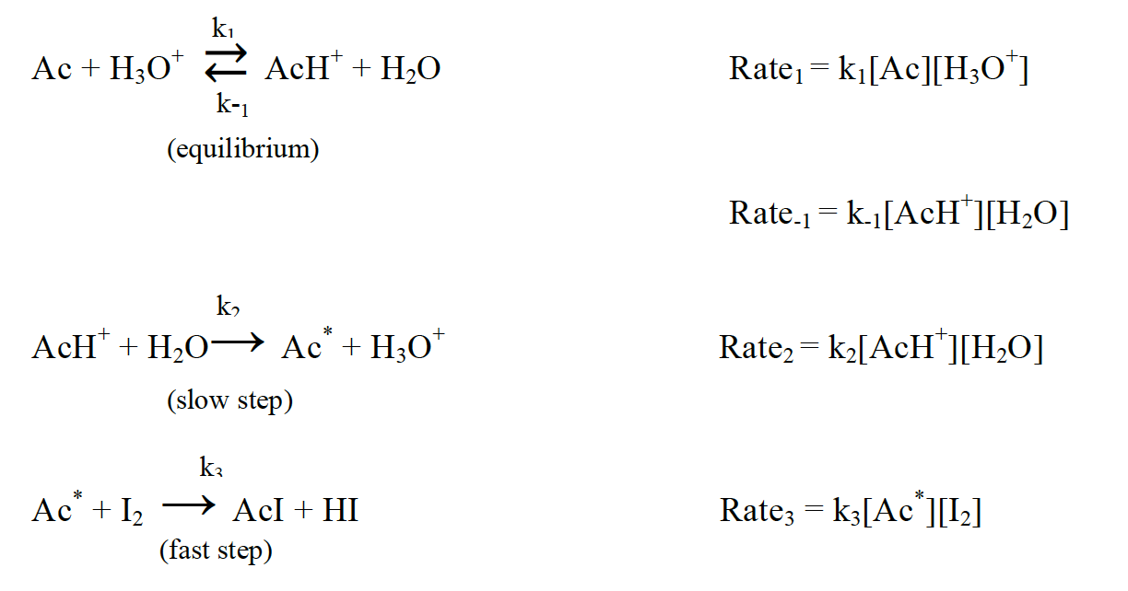

Introduction
Iodination of Acetone:
$$CH_{3}COCH_{3}+I_{2}→CH_{3}COH_{2}I+HI$$
Reaction Mechanism:

Slide 6
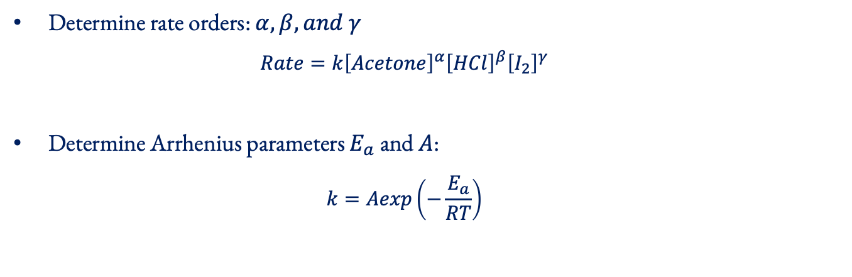
Initial Objectives
Determine rate orders: $α,β, and γ$
$$Rate=k{\left[Acetone\right]}^{α}{\left[HCl\right]}^{β}{\left[I_{2}\right]}^{γ}$$
Determine Arrhenius parameters $E_{a}$ and $A$:
$$k=Aexp\left(−\frac{E_{a}}{RT}\right)$$

Slide 7
Runaway Reactions
Autocatalytic behavior: Hydrogen iodide dissociates into its respective ions (proton generation) and the systems runs the risk of significant temperature increases.
To remedy this issue, HI produced can be electrolyzed and thus reduce proton concentration.
$$CH_{3}COCH_{3}+I_{2}+H^{+}→CH_{3}COH_{2}I+I^{−}+H^{+}$$
$$2HI→H_{2}+I_{2}$$

Slide 8
Reactor Modeling & Sizing
Batch Reactor:
Scenario 1: neglect HI electrolysis
Scenario 2: incorporate HI electrolysis
CSTR:
Determine reactor volume for commercial use using previously obtained kinetic parameters

Slide 9
SAFETY AND EXPERIMENTAL PLAN

Slide 10
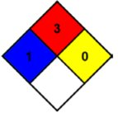
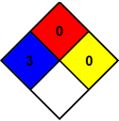
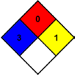
Chemical Hazards
NFPA Diamond for Acetone ¹, Iodine ², 1 M Hydrochloric Acid ³, and Hydrogen Iodide ⁴
¹ Acetone; CAS No. 67-64-1 [Online]; LabChem, Inc; Zelienople, PA, November 12, 1998. https://www.labchem.com/tools/msds/msds/LC10420.pdf (accessed 4/14/21)
² Iodine; CAS No. 7553-56-2 [Online]; LabChem, Inc; Zelienople, PA, November 4, 2003. http://www.labchem.com/tools/msds/msds/LC15590.pdf (accessed 4/14/21)
³ Hydrochloric Acid; CAS No. 7647-01-0 [Online]; LabChem, Inc; Zelienople, PA, July 3, 2013. https://www.labchem.com/tools/msds/msds/LC15300.pdf (accessed 4/14/21)
⁴ Hydrogen Iodide; CAS No. 10034-85-2 [Online]; Matheson Tri-Gas, Inc; Basking Ridge, NJ, March 7, 1990. https://www.mathesongas.com/pdfs/msds/MAT11100.pdf (accessed 4/14/21)

Slide 11
Chemical Exposure Guidelines
Inhalation
Splash
Ingestion
Assist exposed person to fresh air
Call UD Police
Provide CPR if needed and trained
Retrieve SDS and provide it to medical providers
Assist exposed person to safety shower/eyewash
Call UD Police
Remove all contaminated apparel
Retrieve SDS for medical providers
Neoprene gloves must be worn when handling Iodine
Rinse mouth thoroughly
Call UD police
Do not induce vomiting
Have individual drink sips of water
Retrieve SDS for medical providers

Slide 12
Operational Hazards And Precautions
Potential Hazards
Precautions
Sharp Objects:
Needle on the syringes
Fire:
Acetone has a flash point of -20°C
Sharp Objects:
Extra precaution and wear proper PPE
Fire:
Remove any sources of ignition from lab

Slide 13
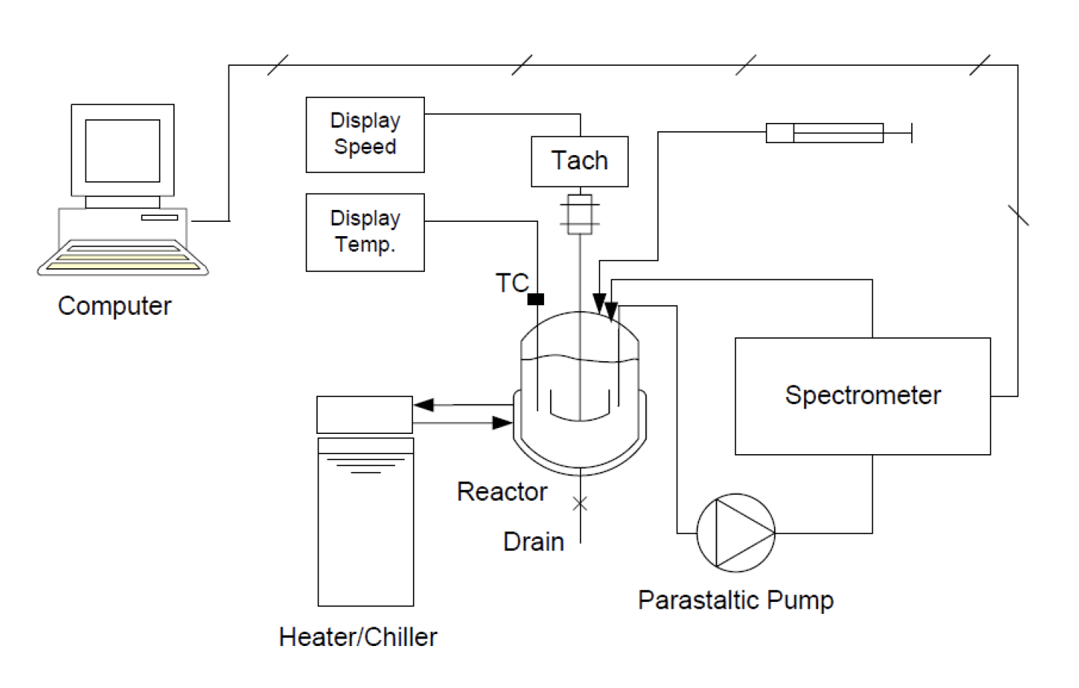
Experimental Plan
Ensure proper PPE is being worn
Locate the chemical and waste disposal sites
Connect hose to waste container and turn on instruments
Perform standard lab work, such as rinsing reactor 3 times with distilled water
Measure and add desired amount of water
Switch on agitator, then measure and add acetone using a funnel.
Once desired temperature is reached, measure and inject HCl
Start circulating pump, calibrate the spectrometer
Measure and inject iodine
After about the first 200 seconds, stop recording and save data
Turn off all instruments, drain the reactor, and repeat for each run
Orazov, M. CHEG 345 Kinetics Experiment. Chemical Engineering Laboratory I: CHEG 345. University of Delaware

Slide 14
DATA ANALYSIS

Slide 15
PHASE I

Slide 16
Runs Conditions
Run # | Temperature (°C) | [Acetone]₀ (M) | [HCl]₀ (M) | [I₂]₀ (M)
1 | 35 | 2 | 0.02 | 0.0020
2 | 35 | 1 | 0.02 | 0.0020
3 | 35 | 3 | 0.02 | 0.0020
4 | 35 | 4 | 0.02 | 0.0020
5 | 35 | 2 | 0.01 | 0.0020
6 | 35 | 2 | 0.03 | 0.0020
7 | 35 | 2 | 0.04 | 0.0020
8 | 35 | 2 | 0.02 | 0.0010
9 | 35 | 2 | 0.02 | 0.0030
10 | 35 | 2 | 0.02 | 0.0040
11 | 30 | 2 | 0.02 | 0.0020
12 | 33 | 2 | 0.02 | 0.0020
13 | 40 | 2 | 0.02 | 0.0020
14 | 38 | 2 | 0.02 | 0.0020
14 runs
1 standard run
3 runs with varying concentration for each reactant
4 runs with varying temperature

Slide 17
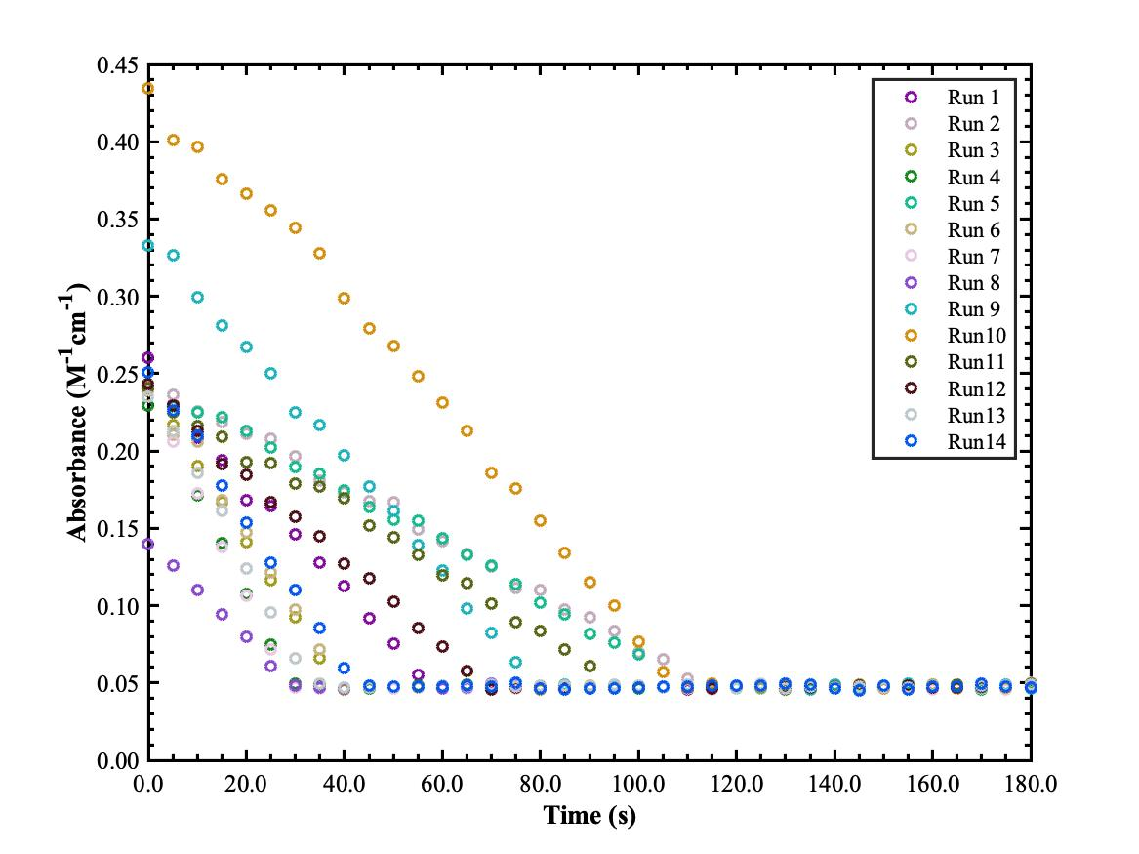
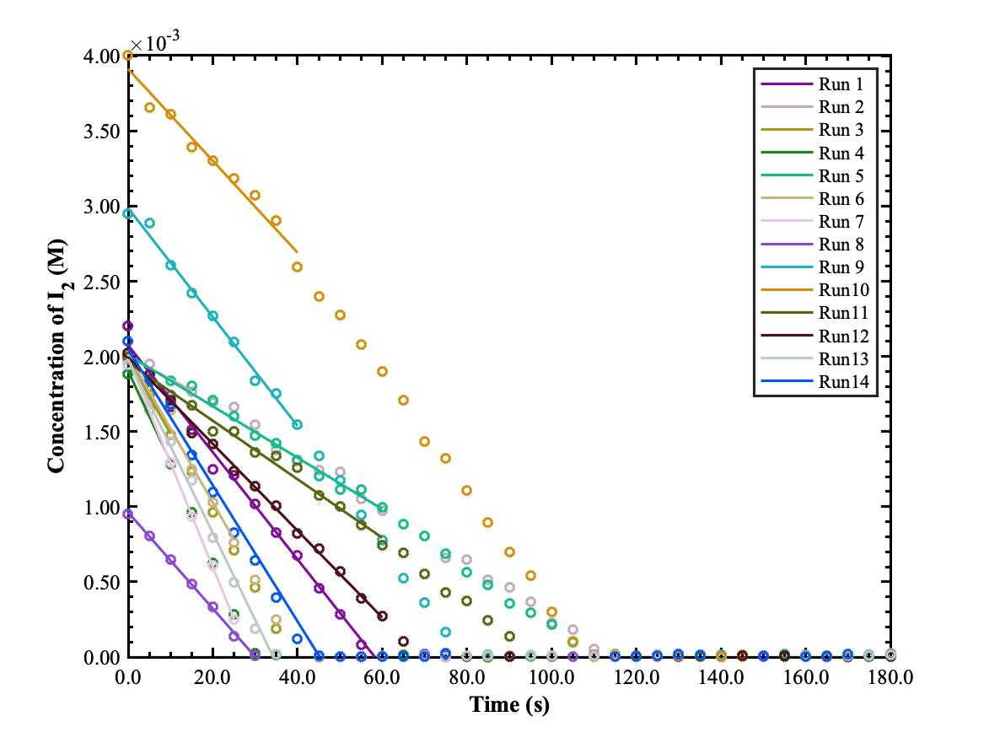
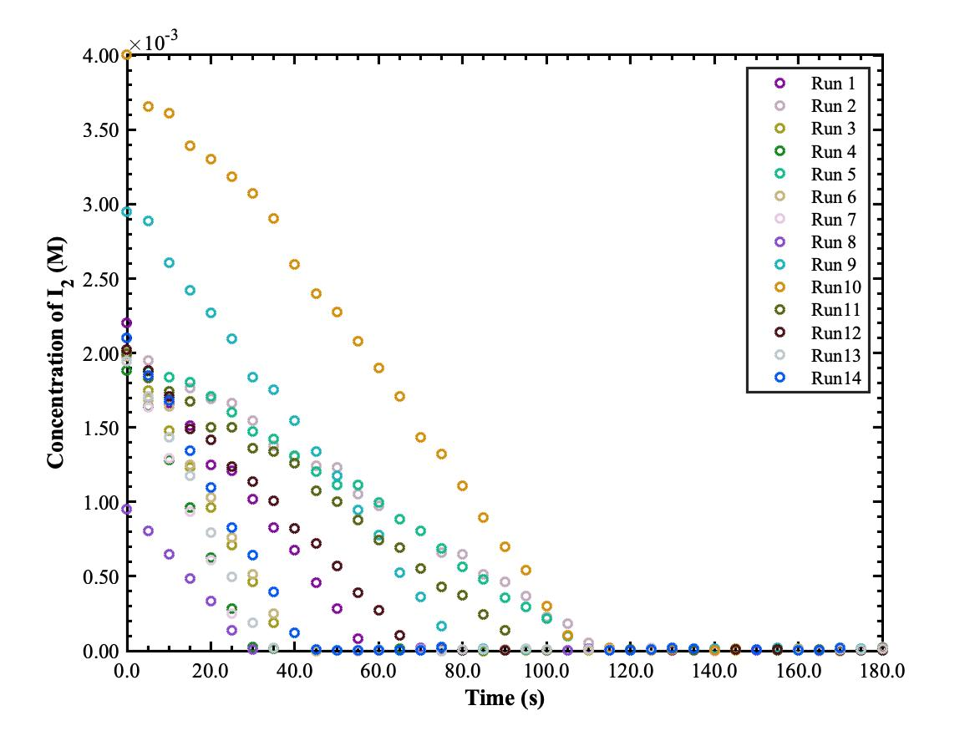
Initial Rate Method

Slide 18
PHASE II

Slide 19
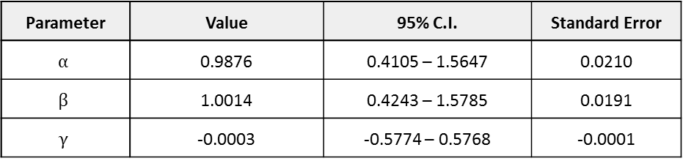
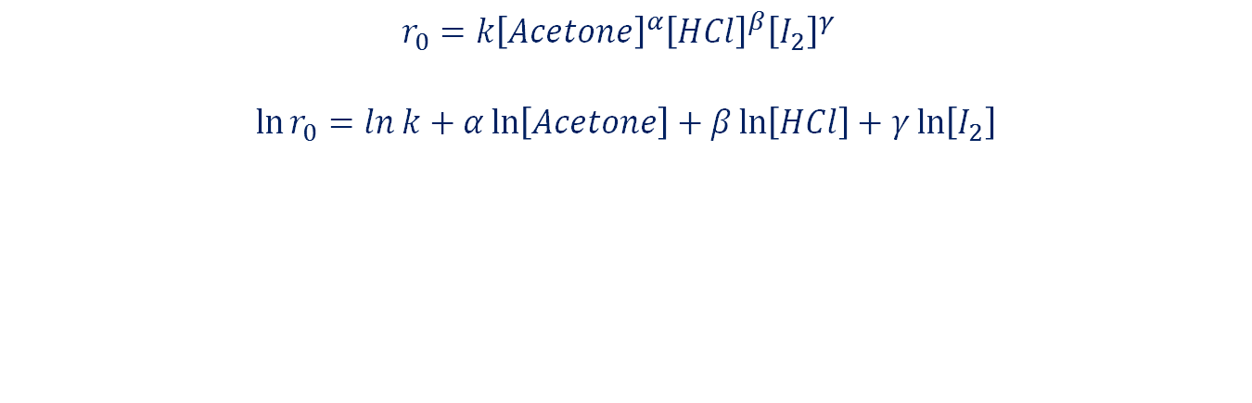
Reaction Orders ª
$$r_{0}={k\left[Acetone\right]}^{α}{\left[HCl\right]}^{β}{\left[I_{2}\right]}^{γ}$$
$$\ln{r_{0}}=\ln{k}+α\ln\left[Acetone\right]+β\ln\left[HCl\right]+γ\ln\left[I_{2}\right]$$
Parameter | Value | 95% C.I. | Standard Error
$$α$$ | 0.9876 | 0.4105 – 1.5647 | 0.0210
$β$ | 1.0014 | 0.4243 – 1.5785 | 0.0191
$$γ$$ | -0.0003 | -0.5774 – 0.5768 | -0.0001
ª See Supplementary A for detailed work
Notes:
USE MULTIPLE LINEAR REGRESSIONS
Didn’t do linear regressions on runs with varying a specific reactant to find the reaction order for that species, cuz it will create bias towards that reactants, since we didn’t consider all run at once
So to eliminate that bias, do multiple linear regressions all at once instead

Slide 20
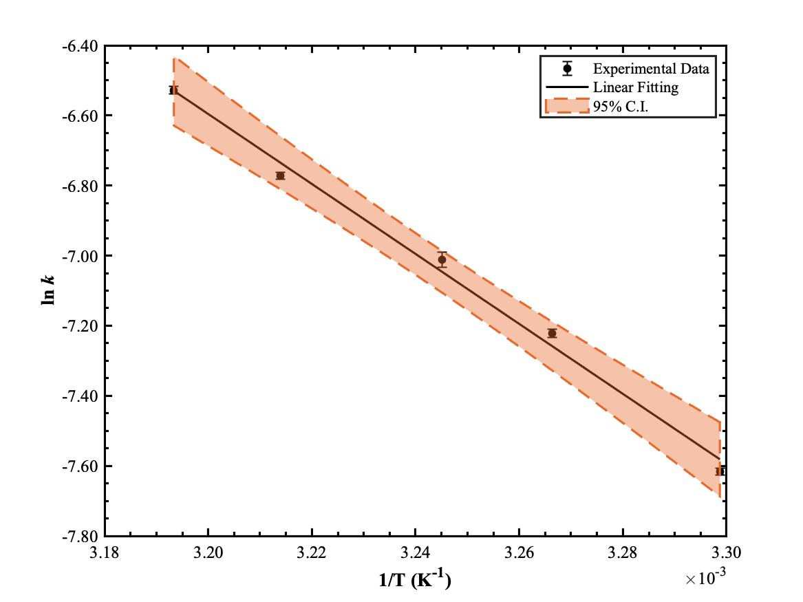

Arrhenius Plot
$$\ln{k}=−\frac{E_{a}}{R}⋅\frac{1}{T}+\ln{A}$$
Parameter | Values | 95% Confidence Interval
A (M⁻¹s⁻¹) | 1.026x10¹¹ | 5.951x10⁸ - 1.769x10¹³
E_{a} (kJ/mol) | 83.0101 | 69.8104 - 96.2098

Slide 21
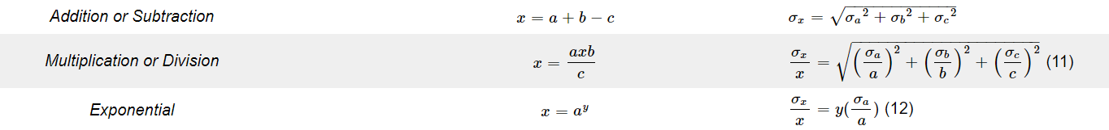

Error Propagation
Errors in mass, absorbance, and temperature were propagated
Sources: Spectrophotometer, Thermocouple, and Balance
Reaction Orders – Method of Initial Rates
k – rate expression
Errors in regression: slope and intercept
Rate – Least Squares
E_{a} & A – sum of squares
$$k=\frac{r_{0}}{{\left[Acetone\right]}^{α}{\left[HCl\right]}^{β}{\left[I_{2}\right]}^{γ}}$$

Slide 22
PHASE III

Slide 23
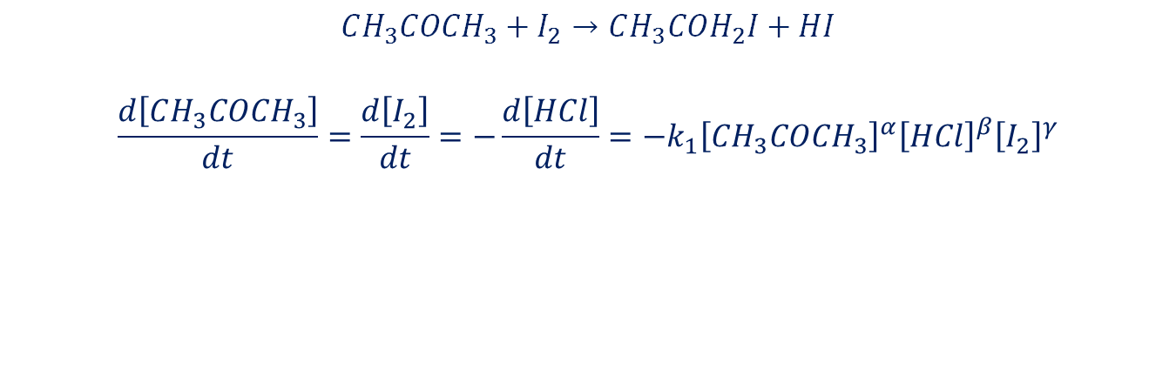
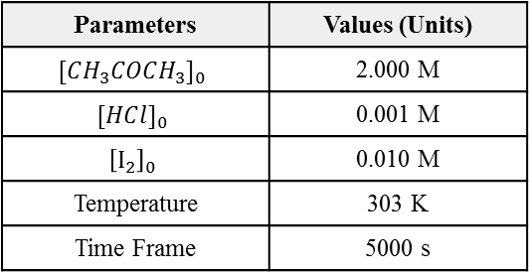
Part 1 – ODE Simulation for BSTR
$$CH_{3}COCH_{3}+I_{2}→CH_{3}COH_{2}I+HI$$
$$\frac{d\left[CH_{3}COCH_{3}\right]}{dt}=\frac{d\left[I_{2}\right]}{dt}=−\frac{d\left[HCl\right]}{dt}=−k_{1}{\left[CH_{3}COCH_{3}\right]}^{α}{\left[HCl\right]}^{β}{\left[I_{2}\right]}^{γ}$$
Parameters | Values (Units)
$[CH_{3}COCH_{3}]_{0}$ | 2.000 M
$[HC{l]}_{0}$ | 0.001 M
$${\left[I_{2}\right]}_{0}$$ | 0.010 M
Temperature | 303 K
Time Frame | 5000 s

Slide 24
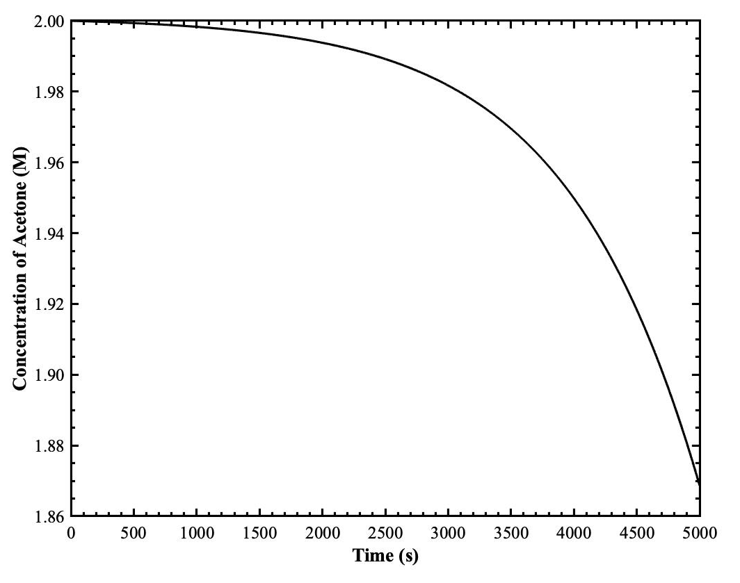
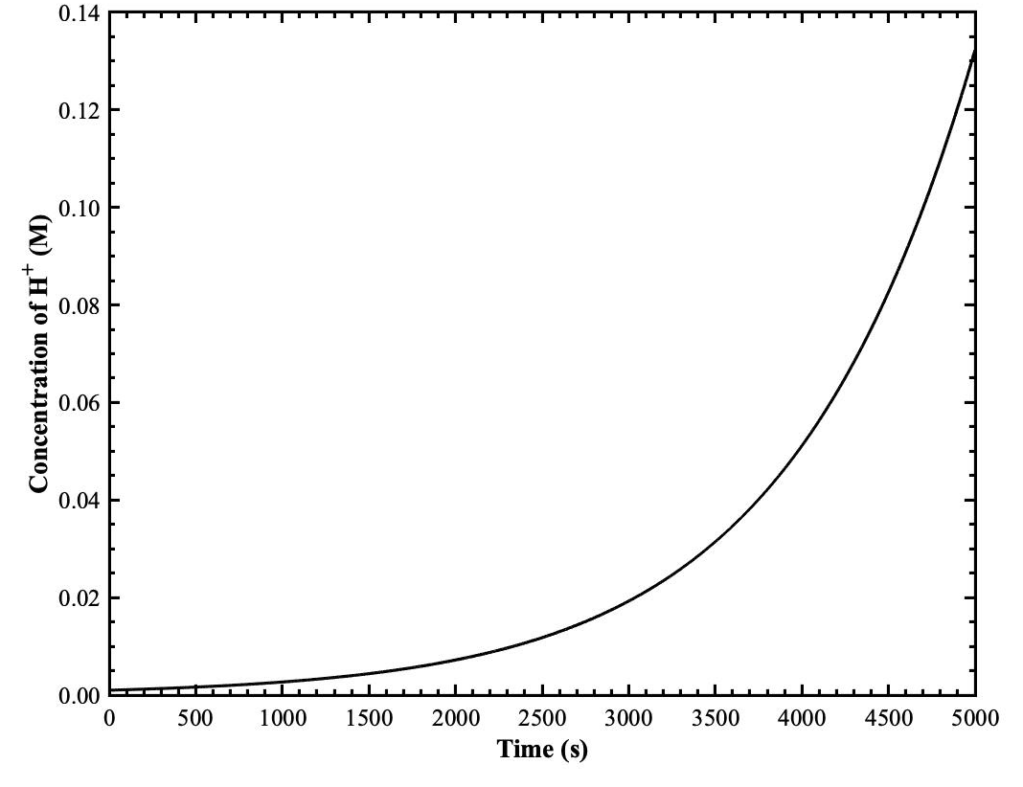


Part 1
$\left[CH_{3}COCH_{3}\right]$ Concentration Profile
$\left[H^{+}\right]$ Concentration Profile

Slide 25
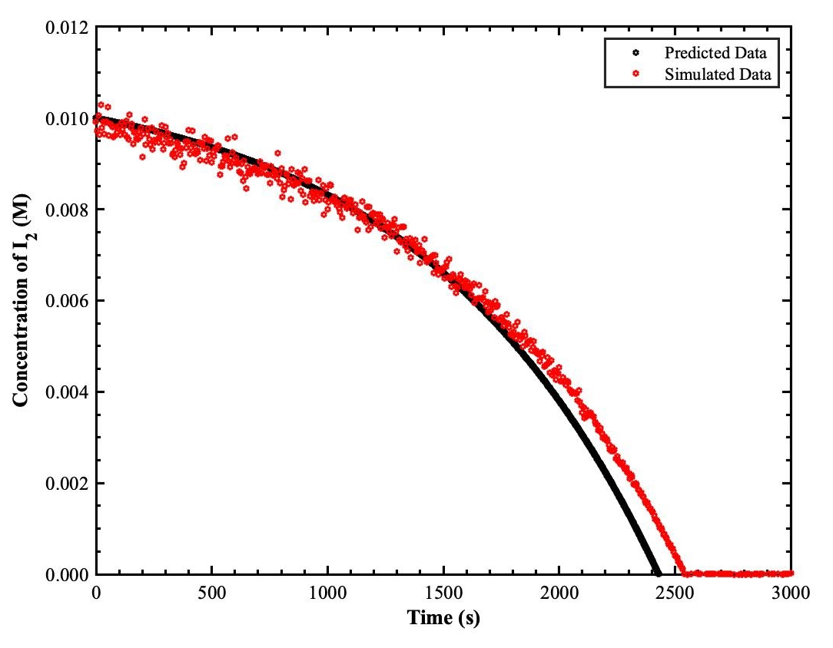

Part 1
$\left[I_{2}\right]$ Concentration Profile

Slide 26
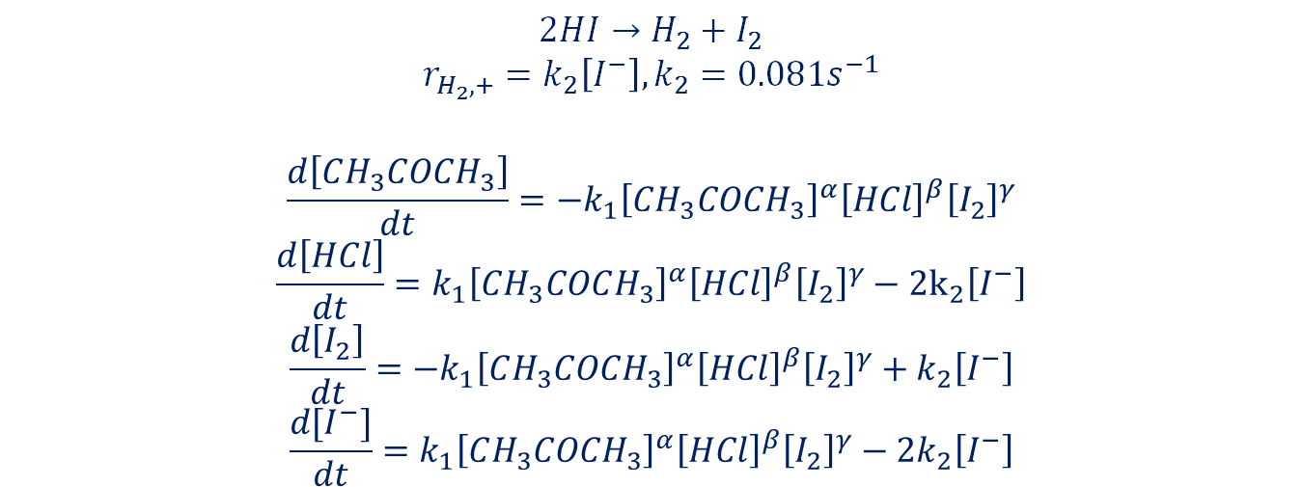
Part 2 – BSTR with Electrolysis Reaction
$$2HI→H_{2}+I_{2}$$
$$r_{H_{2},+}=k_{2}\left[I^{−}\right], k_{2}=0.081s^{−1}$$
$$\frac{d\left[CH_{3}COCH_{3}\right]}{dt}=−k_{1}{\left[CH_{3}COCH_{3}\right]}^{α}{\left[HCl\right]}^{β}{\left[I_{2}\right]}^{γ}$$
$$\frac{d\left[HCl\right]}{dt}=k_{1}{\left[CH_{3}COCH_{3}\right]}^{α}{\left[HCl\right]}^{β}{\left[I_{2}\right]}^{γ}−2k_{2}\left[I^{−}\right]$$
$$\frac{d\left[I_{2}\right]}{dt}={−k}_{1}{\left[CH_{3}COCH_{3}\right]}^{α}{\left[HCl\right]}^{β}{\left[I_{2}\right]}^{γ}+k_{2}\left[I^{−}\right]$$
$$\frac{d[I^{−}]}{dt}=k_{1}{\left[CH_{3}COCH_{3}\right]}^{α}{\left[HCl\right]}^{β}{\left[I_{2}\right]}^{γ}−2k_{2}\left[I^{−}\right]$$

Slide 27
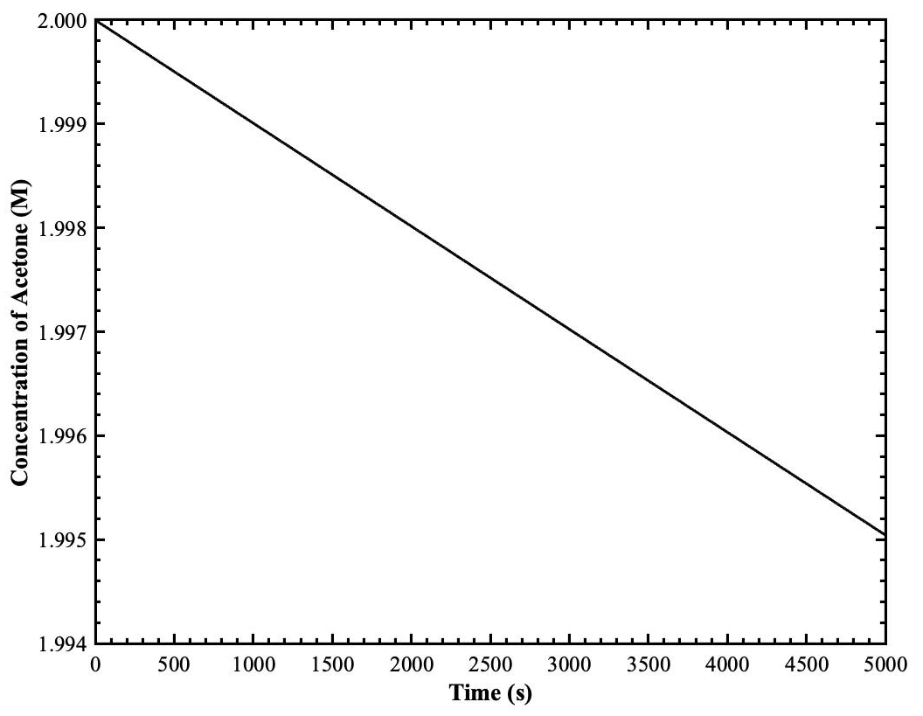
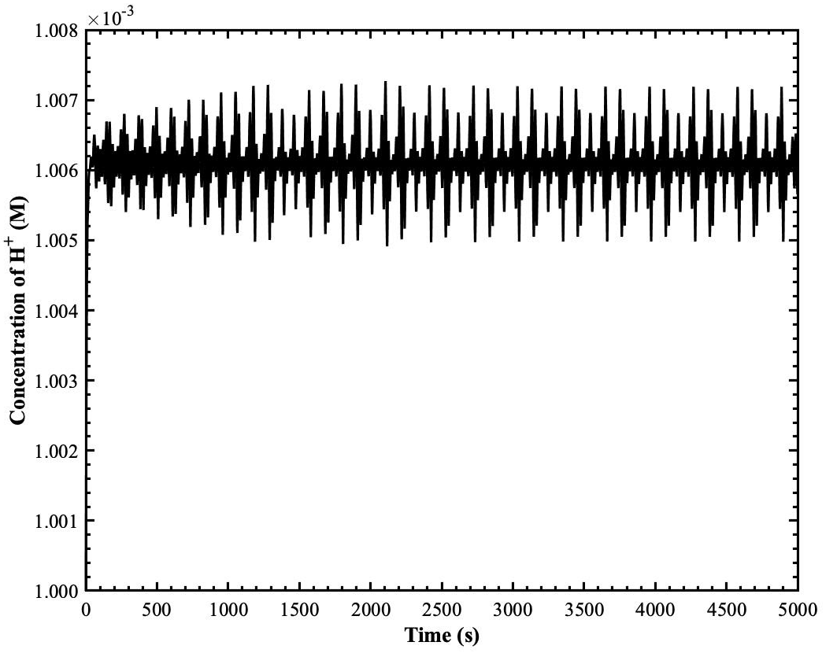
Part 2
$\left[CH_{3}COCH_{3}\right]$ Concentration Profile
$\left[H^{+}\right]$ Concentration Profile
Notes:
Does not decrease exponentially like observed in part 1, approximately linear instead. The concentration is also slightly greater than in part 1. It makes sense because the electrolysis reaction exists, slows down the main reaction, so less acetone consumed.
Proton concentration fluctuate around the same number, makes conceptual sense because it’s constantly being consumed by second reaction, but produced by the main reaction. Unlike from part 1, it’s constantly being produced, so the concentration increases with time.

Slide 28
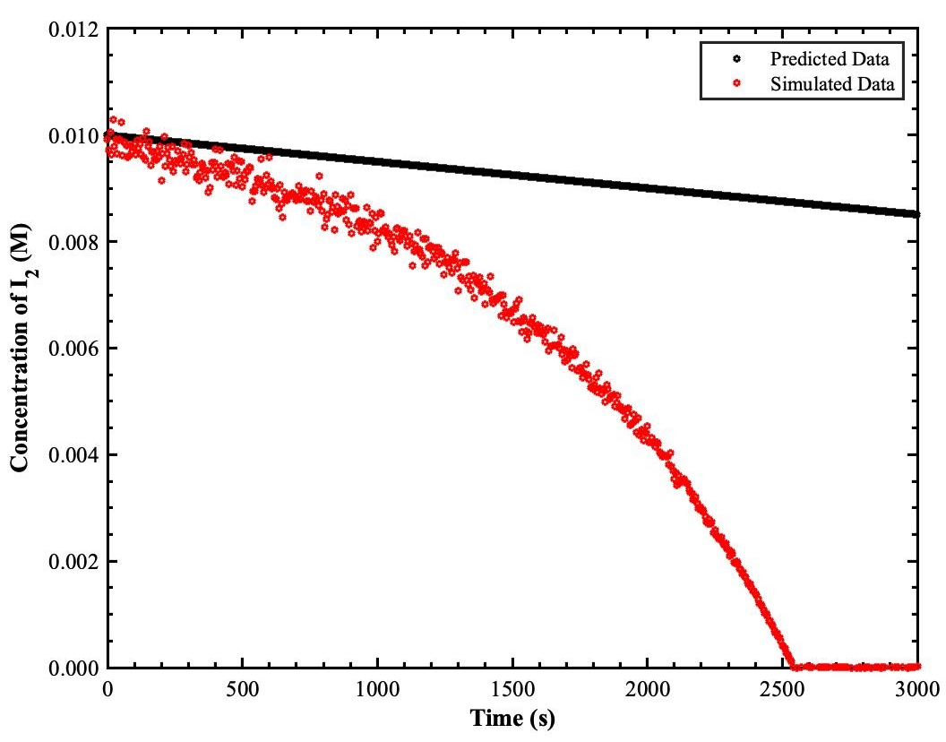
Part 2
$\left[I_{2}\right]$ Concentration Profile
Notes:
Here we see that simulation data from pcode do not consider the electrolysis reaction, so concentration will start to decrease exponentially due to the autocatalytic behavior. And remember that our goal is to remove this behavior in our system from happening because it can cause some issue with the system control. So, by having the second reaction, iodine is consumed in the first reaction but then regenerate in the second reaction, in order to ensure a higher concentration of iodine in the system, and not having it exponentially decrease with time. This is closely related to the concentration of HI in the system so more I2 need to be produced to reduce HI, so the autocatalytic behavior can be prevented at least.

Slide 29
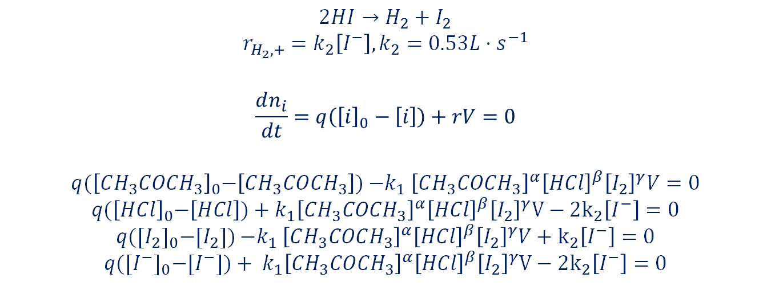
Part 3 – CSTR with Electrolysis Reaction
$$2HI→H_{2}+I_{2}$$
$$r_{H_{2},+}=k_{2}\left[I^{−}\right], k_{2}=0.53L⋅s^{−1}$$
$$\frac{dn_{i}}{dt}=q\left({\left[i\right]}_{0}−\left[i\right]\right)+rV=0$$
$$q{(\left[CH_{3}COCH_{3}\right]}_{0}−\left[CH_{3}COCH_{3}\right]){−k}_{1}{\left[CH_{3}COCH_{3}\right]}^{α}{\left[HCl\right]}^{β}{\left[I_{2}\right]}^{γ}V=0$$
$$q{(\left[HCl\right]}_{0}−\left[HCl\right])+k_{1}{\left[CH_{3}COCH_{3}\right]}^{α}{\left[HCl\right]}^{β}{\left[I_{2}\right]}^{γ}V−2k_{2}\left[I^{−}\right]=0$$
$$q{([I_{2}]}_{0}−[I_{2}]){−k}_{1}{\left[CH_{3}COCH_{3}\right]}^{α}{\left[HCl\right]}^{β}{\left[I_{2}\right]}^{γ}V+k_{2}\left[I^{−}\right]=0$$
$$q{([I^{−}]}_{0}−[I^{−}])+ k_{1}{\left[CH_{3}COCH_{3}\right]}^{α}{\left[HCl\right]}^{β}{\left[I_{2}\right]}^{γ}V−2k_{2}\left[I^{−}\right]=0$$

Slide 30
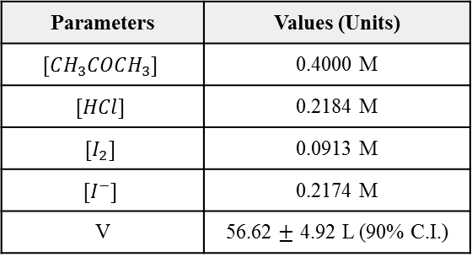
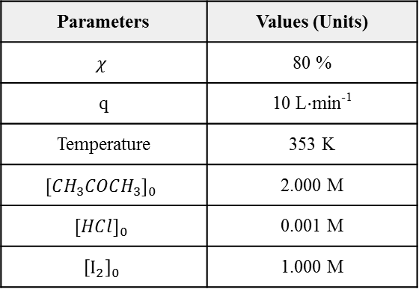
CSTR Sizing
Parameters | Values (Units)
$$χ$$ | 80 %
q | 10 L$⋅$min⁻¹
Temperature | 353 K
$[CH_{3}COCH_{3}]_{0}$ | 2.000 M
$[HC{l]}_{0}$ | 0.001 M
$${\left[I_{2}\right]}_{0}$$ | 1.000 M
Parameters | Values (Units)
$[CH_{3}COCH_{3}]$ | 0.4000 M
$$[HCl]$$ | 0.2184 M
$$[I_{2}]$$ | 0.0913 M
$$[I^{−}]$$ | 0.2174 M
V | 56.62 $±$ 4.92 L (90% C.I.)

Slide 31
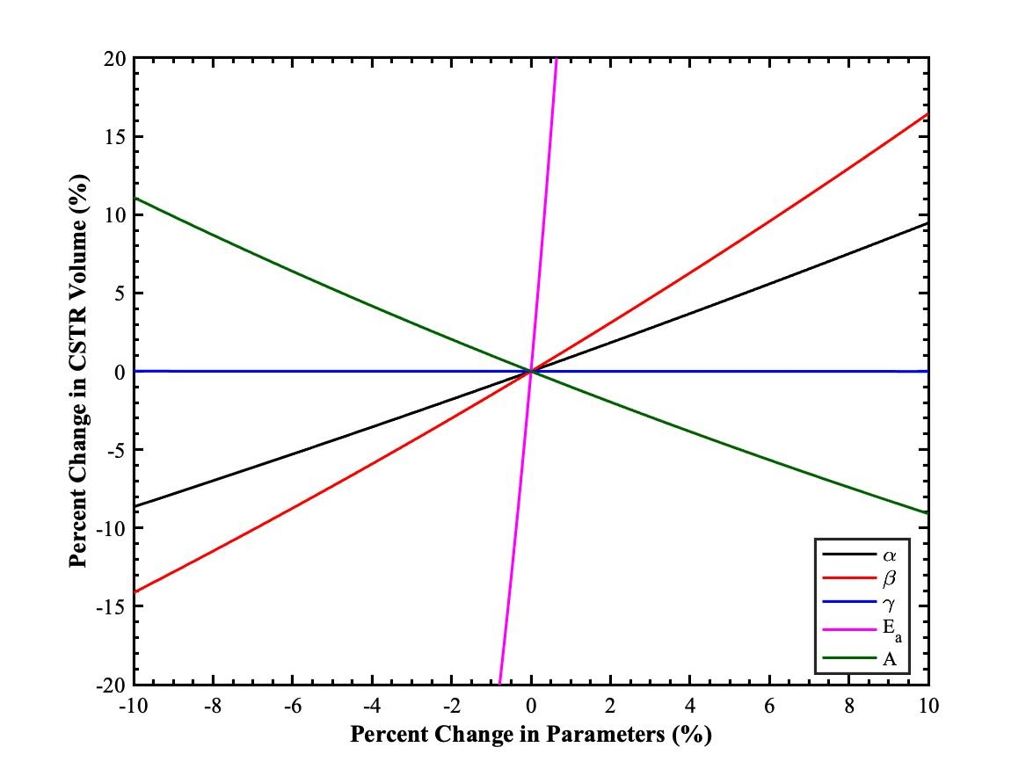
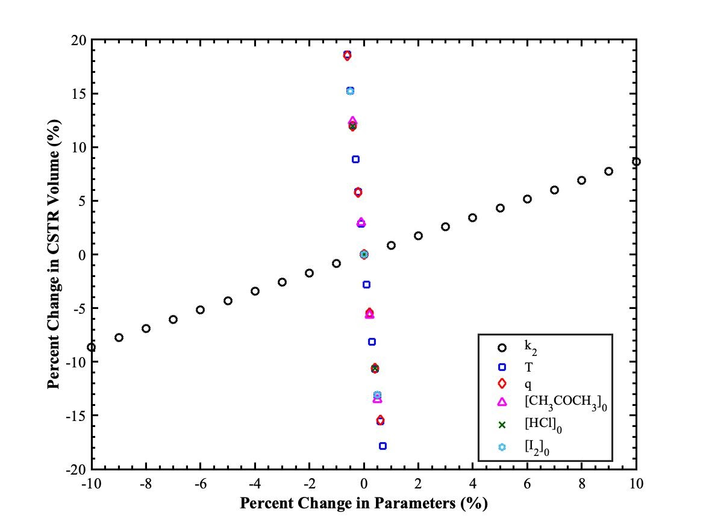
Sensitivity Analysis – CSTR Sizing
Notes:
Alpha/beta – from the equation, increasing this parameters, will make the concentration associated with the order to be smaller (0.04^2 > 0.04^3 because we’re considering a number raised to a certain power, and this number is less than 1). So, volume will increase along the way. Conceptually speaking, because the concentration becomes more smaller due to a concentration less than 1,
For gamma, varying around 0, won’t have a significant effect on the volume.
Increasing A will increase the k. So as k increases, volume will decrease, which makes sense because faster reaction happening at a time, so no need a bigger volume.
Increasing Ea, will decrease the k, opposite argument as previously mentioned.
If k2 increases, volume increases. We know the second reaction is a competing reaction from the main reaction. When k2 is greater than k1, HI is consumed a lot faster than it is being produced in the main reaction. From here, to achieve the same amount of product, we need to accommodate with a higher volume for the first reaction to occur simultaneously to meet the end goals.
The rest of the parameters, temperature, flow rate, initial concentration, decrease volume as they increase. For T, related to Boltzmann distribution curve, at a fixed Ea, greater T will have a greater probability of molecule to get over the barrier of energy, more collision, faster kinetics.
Initial concentration related to le chateliers principle, adding more reactants will drive the equilibrium to produce more product, so faster reaction, less vol needed.
Q is related by, increasing flow rate, but at the same residence time to achieve the same conversion, we need a lower volume, mathematically correct.

Slide 32
Conclusion and Recommendation
Reaction orders and Arrhenius parameters were determined using a combination of experimental and mathematical analysis of the iodination of acetone reaction:
⍺=0.987 ± 0.021 𝛽=1.001 ± 0.019 γ= -0.0003± 0.0001
E_{a} = 83.01 ± 7.07 kJ/mol A = 1.026 x 10¹¹ ± 1.414 x 10¹⁰ M⁻¹s⁻¹
Created System of ODEs to model reaction in BSTR and CSTR
Analyzed autocatalytic regime of reaction independently and then in conjunction with HI electrolysis
80% acetone conversion with electrolysis reaction requires a 56.62 ± 4.92 L CSTR
Autocatalytic regime and electrolysis model compared to experimental results when lab opportunities present themselves again

Slide 33
THANK YOU!

Slide 34
SUPPLEMENTARY

Slide 35
SUPPLEMENTARY A: Multiple Linear Regression
Run # | Initial Rate, r₀ (M/s) | u_{r0} (M/s) | [Acetone]₀ (M) | [HCl]₀ (M) | [I₂]₀ (M) | ln r₀ | ln [Acetone]₀ | ln [HCl]₀ | ln [I₂]₀
1 | 3.5604E-05 | 9.1040E-07 | 2.000 | 0.020 | 0.0020 | -10.2431 | 0.6931 | -3.9120 | -6.2146
2 | 1.5291E-05 | 2.0312E-06 | 1.000 | 0.020 | 0.0020 | -11.0882 | 0.0000 | -3.9120 | -6.2146
3 | 4.9796E-05 | 2.4805E-06 | 3.000 | 0.020 | 0.0020 | -9.9076 | 1.0986 | -3.9120 | -6.2146
4 | 6.0234E-05 | 6.8145E-06 | 4.000 | 0.020 | 0.0020 | -9.7173 | 1.3863 | -3.9120 | -6.2146
5 | 1.7092E-05 | 5.0035E-07 | 2.000 | 0.010 | 0.0020 | -10.9769 | 0.6931 | -4.6052 | -6.2146
6 | 4.9220E-05 | 3.5715E-06 | 2.000 | 0.030 | 0.0020 | -9.9192 | 0.6931 | -3.5066 | -6.2146
7 | 6.9323E-05 | 3.4030E-07 | 2.000 | 0.040 | 0.0020 | -9.5767 | 0.6931 | -3.2189 | -6.2146
8 | 3.2025E-05 | 5.4560E-07 | 2.000 | 0.020 | 0.0010 | -10.3490 | 0.6931 | -3.9120 | -6.9078
9 | 3.6251E-05 | 1.1631E-06 | 2.000 | 0.020 | 0.0030 | -10.2250 | 0.6931 | -3.9120 | -5.8091
10 | 3.0549E-05 | 1.9934E-06 | 2.000 | 0.020 | 0.0040 | -10.3962 | 0.6931 | -3.9120 | -5.5215
11 | 1.9456E-05 | 6.4025E-07 | 2.000 | 0.020 | 0.0020 | -10.8474 | 0.6931 | -3.9120 | -6.2146
12 | 2.8866E-05 | 4.5988E-07 | 2.000 | 0.020 | 0.0020 | -10.4529 | 0.6931 | -3.9120 | -6.2146
13 | 5.7767E-05 | 1.6237E-06 | 2.000 | 0.020 | 0.0020 | -9.7591 | 0.6931 | -3.9120 | -6.2146
14 | 4.5263E-05 | 1.8942E-06 | 2.000 | 0.020 | 0.0020 | -10.0030 | 0.6931 | -3.9120 | -6.2146
Regression Statistics
Multiple R | 0.86301
R² | 0.74478
Adjusted R² | 0.66821
Standard Error | 0.27330
Observations | 14
ANOVA
Parameter | df | SS | MS | F | Significance F
Regression | 3 | 2.17959 | 0.72653 | 9.72718 | 0.00260
Residual | 10 | 0.74691 | 0.07469
Total | 13 | 2.92650
Parameter | Coefficients | Standard Error | t Stat | P-value | Lower 95% | Upper 95%
Intercept | -7.0739 | 1.9086 | -3.7063 | 0.0041 | -11.3266 | -2.8213
ln [Acetone]₀ | 0.9876 | 0.2590 | 3.8129 | 0.0034 | 0.4105 | 1.5647
ln [HCl]₀ | 1.0014 | 0.2590 | 3.8662 | 0.0031 | 0.4243 | 1.5785
ln [I₂]₀ | -0.0003 | 0.2590 | -0.0012 | 0.9990 | -0.5774 | 0.5768

